Slide 1





Enhancing Visualization: International Cricket Council World Cup 2023
Group Members
Md. Jobaer Hossain[19202203001][Leader]
Md. Alamin [19202203109]
Supervised By
Fahim Chowdhury [19202203013]
Mamun Hasan
Assistant Professor
Department of Computer Science and Engineering Bangladesh University Of Business and Technology
Bangladesh University of Business and Technology
Dhaka, Bangladesh
20 Dec, 2023
www.bubt.edu.bd

Slide 2











CONTENT OUTLINE
Introduction
Comparative Analysis
Motivation
Proposed Model
Problem Analysis
Model Evaluation
Related Work
Performance Analysis
Research Contribution
Hyperparameter Tuning
Dataset
Conclusion

Slide 3





Problem Solving and Decision Making
Efficient Information Processing
Facilitating Intelligent Systems
Introduction
Advanced Algorithms
Expert Systems and Decision Support
Problem Domain Understanding

Slide 4





Internal and External Forces
Goal-Oriented Behavior
Intrinsic and Extrinsic Motivation
Comparative Analysis
Data Availability
Motivation
Self-Efficacy and Confidence

Slide 5
Innovation
Critical Thinking
Time
Consuming
Problem Statement
Identification and Definition

Slide 6




Research Contribution
Visualization of Data
Data Clustering
Model Selection
Graph Representation

Slide 7

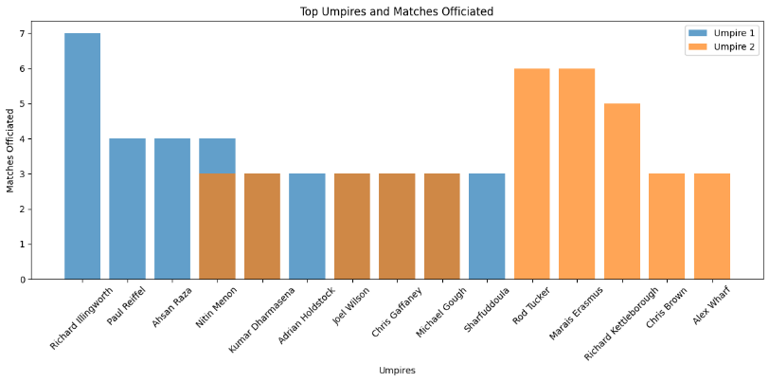
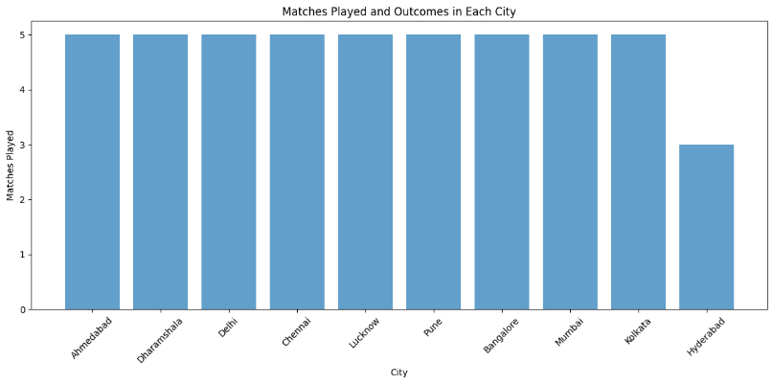
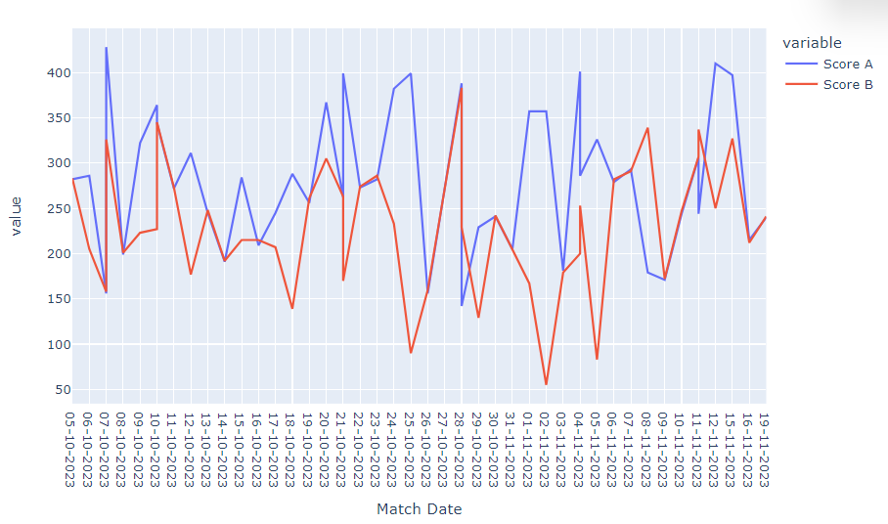
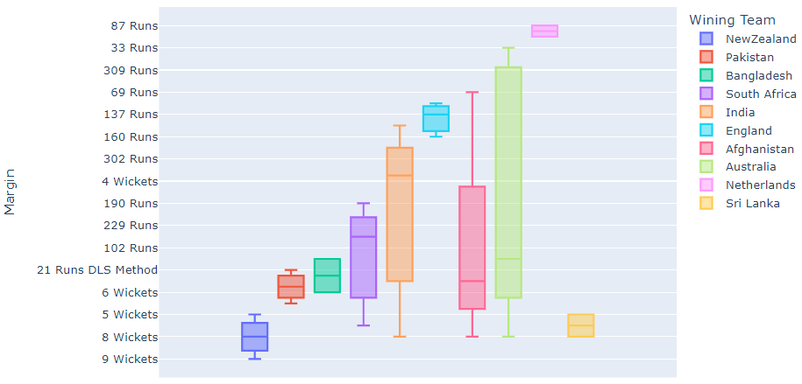
DATASETS
-ICC World Cup 2023

Slide 8
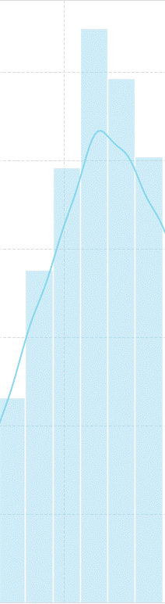
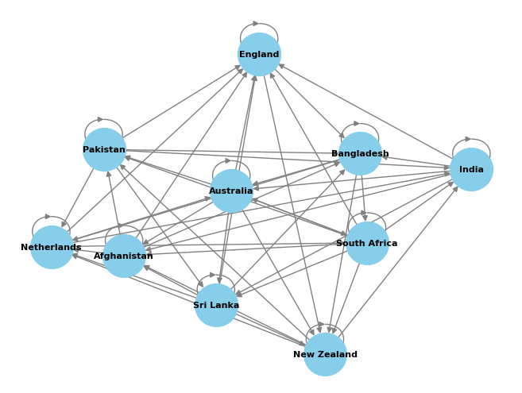
Toss Winner

Slide 9
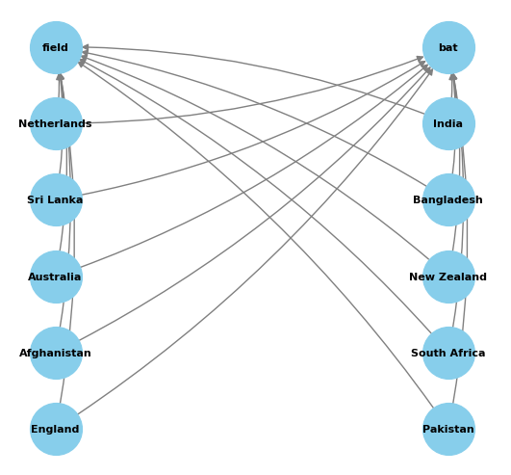
Toss Decision

Slide 10
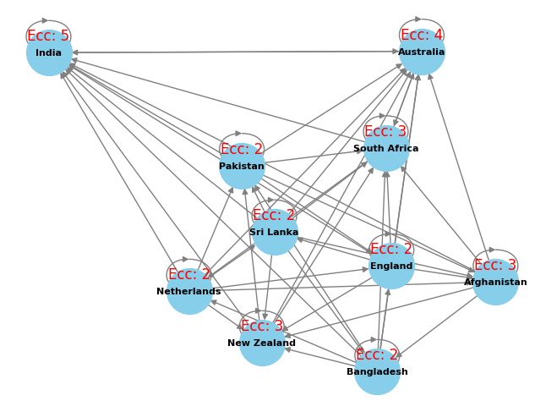
Eccentricity of the Graph

Slide 11
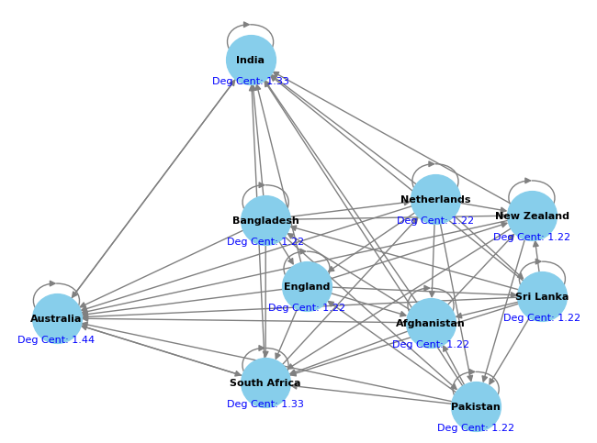
Centrality of the Graph

Slide 12
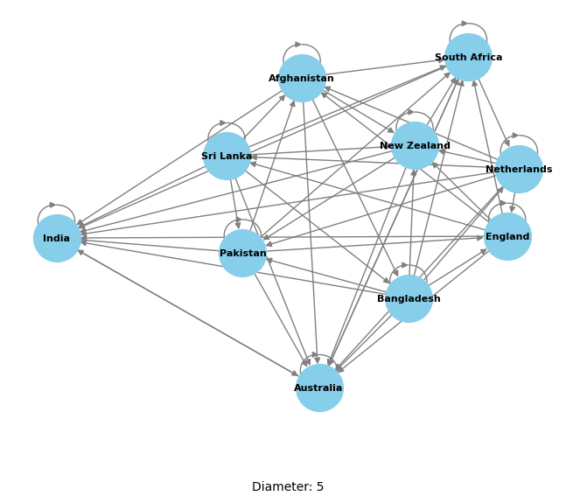
Diameter of the Graph

Slide 13
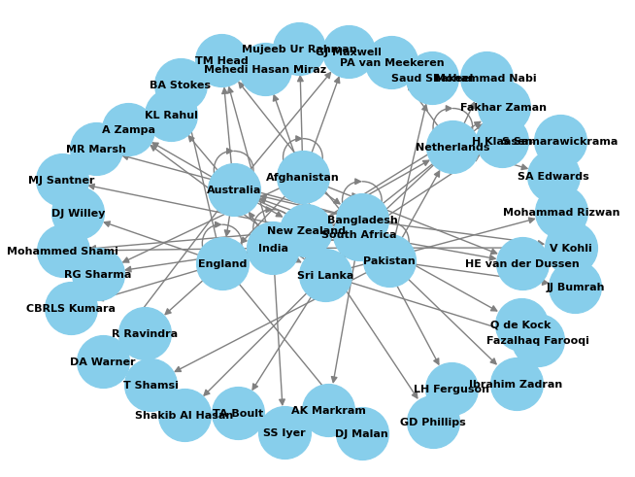
Man of the Player

Slide 14
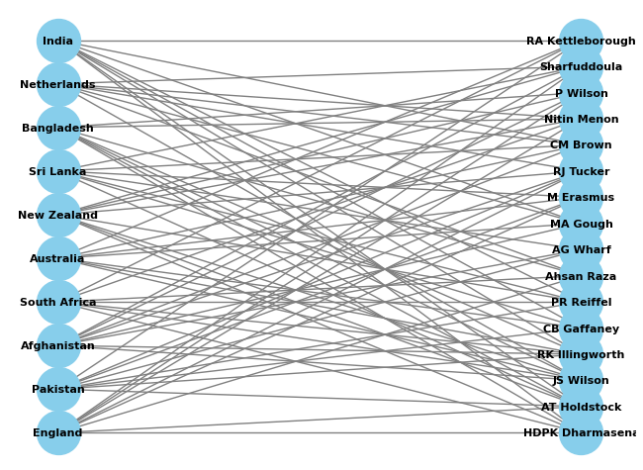
Umpired

Slide 15
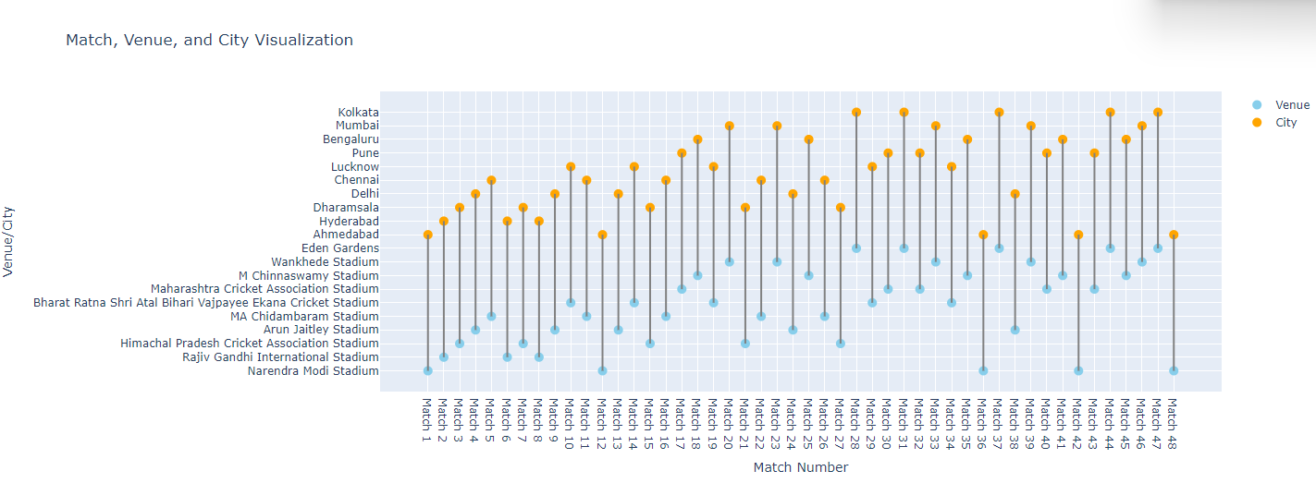

Slide 16
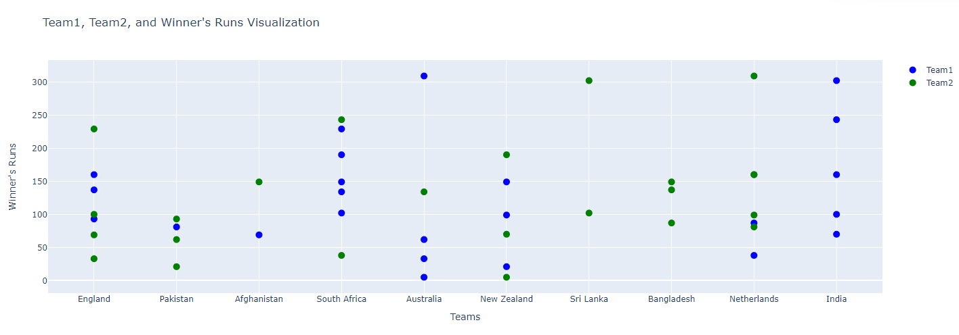

Slide 17
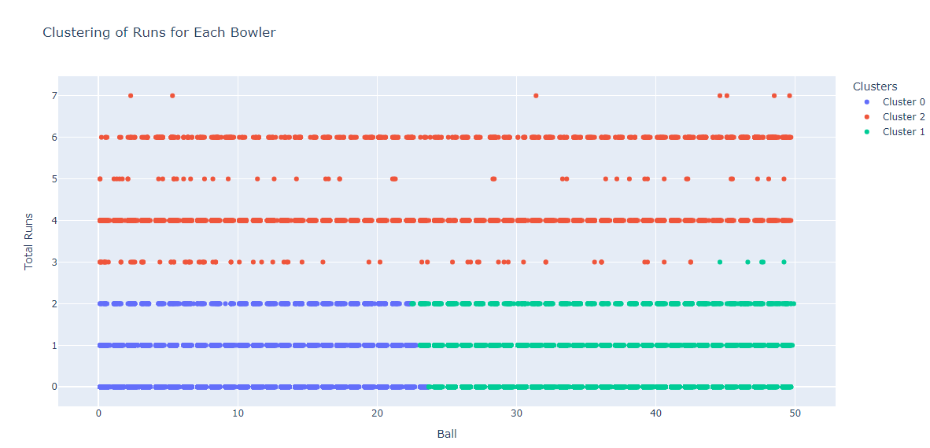

Slide 18
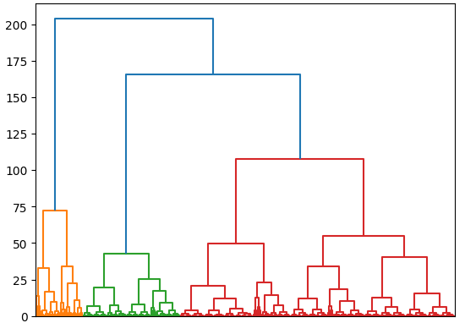

Slide 19

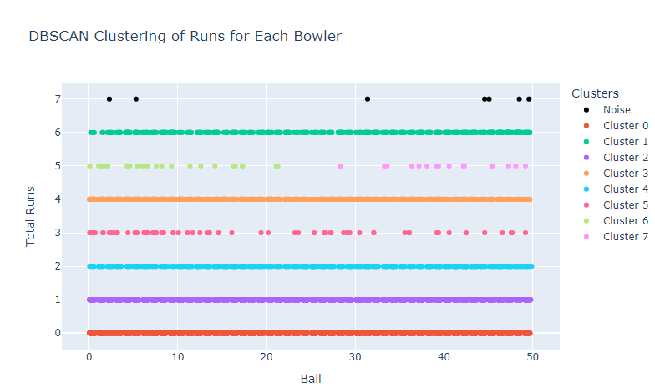

Slide 20

MODEL EVALUATION
12/20/2023
20

Slide 21
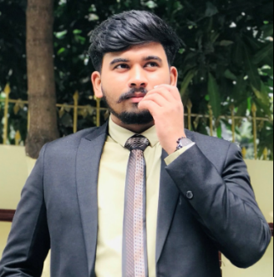

OUR TEAM
Md. Jobaer Hossain ID: 19202203001 B.Sc in CSE, BUBT
Fahim Chowdhury ID: 19202203013 B.Sc in CSE, BUBT
Md. Alamin ID: 19202203109 B.Sc in CSE, BUBT

Slide 22
Conclusion and Future Work

